Slide 1
Day 1
Database Basics and Schema

Slide 2
Agenda
Database
Tables
Keys
Data Types

Slide 3
Database
Data – raw piece of information
Information – processed data(ex: weather report from temperature in Celsius or Fahre)
Database
Organizing the group of data
Easily accessed and managed

Slide 4
Query Overview
Database
Query – Create/Insert/Update/Delete
Project – Usecase / Scenario
Information
Query - Select

Slide 5
Software
Server Products - database
MySQL
Oracle
Tools – development environment
MySQL Workbench
Oracle SQL developer / SQL Plus
Language – SQL – Structured Query Language

Slide 6
Database Creation - MySQL
Syntax
CREATE DATABASE database_name;
Example
CREATE DATABASE BMS_DB;

Slide 7
Table
CUSTOMERS
ACCOUNTS
BANK_DB
BANKS
CUSTOMER_REFERENCES

Slide 8
Sample Database & Tables
SWIGGY_DB – RESTAURANTS, CUSTOMERS, ORDERS, RECOMMENDATIONS, FOOD
PRODUCT_DB – PRODUCTS,RECOMMENDATIONS, REVIEWS, USERS,CATEGORIES

Slide 9
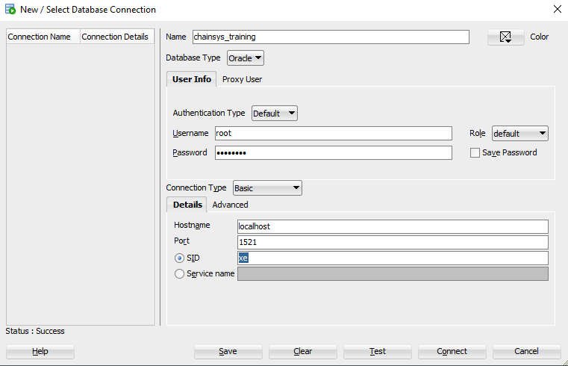
SQL Developer

Slide 10
Oracle
Oracle database is a relational DBMS (Database Management System)
Edition
Enterprise Edition
Express Edition (XE)
Standard Edition
Oracle Lite
Lawrence Ellision (Larry Ellision) - 1977

Slide 11
Constraints
Not Null
Primary Key = unique + not null
Syntax
CONSTRAINT CONSTRAINT_NAME PRIMAY KEY(COLUMN_NAME)
Foreign Key
Syntax
CONSTRAINT CONSTRAINT_NAME FOREIGN KEY(CHILD_COLUMN_NAME) REFERENCES PARENT_TABLE(PARENT_COLUMN_NAME)
Best Practices
Column Level ( Not recommended)
Table Level (Recommended)

Slide 12
Thank You
https://professionalcoders.slack.com/join/shared_invite/zt-pymoh575-UzhQVi5Mdwajlwvue1A0DA#/

